Slide 1
Basics of Information System Design
Notes:
Lecture# 02
July 26. 2007
IT60105: D Samanta, SIT, IIT Kharagpur

Slide 2
What is a System?
A collection of parts that work together to achieve a goal/task
  Examples; Solar system, Digestive systems, Computer system, Information system etc.
A set of objects and relationships among the objects viewed as a whole and designed to achieve a purpose
Information System Design

Slide 3
What is subsystem?
A subsystem is simply a system within a system.
  Automobile is a system composed of subsystems: Engine system, Body system, Frame system
Each of these subsystem is composed of sub-sub --systems.
  Engine system: carburetor system, generator system, fuel system, and so on.
Information System Design

Slide 4
System Concepts
Decomposition
  The process of breaking down a system into smaller components
  Allows the systems analyst to:
  Break a system into small, manageable subsystems
  Focus on one area at a time
  Concentrate on component pertinent to one group of users
  Build different components at independent times
Modularity
  Process of dividing a system into modules of a relatively uniform size and Modules simplify system design
Coupling
  Subsystems that are dependent upon each other are coupled. It is the measure of dependency between one or more systems
Cohesion
  Extent to which a subsystem performs a single function. It is the measure of robustness or strength of a module
Information System Design

Slide 5
System Concepts
Coupling
It is the strength of interconnection between the modules. It is the measure of the degree of interdependency between the modules.
Modules are either loosely coupled or strongly coupled.
In strong coupling, two modules are dependent on each other. Strong coupling can be observed in assembly language programs where change in one part or data requires changes in other parts of the system.
Also, these are difficult to reuse, test, and release for the operation.
In loose coupling, there are weak interconnections between modules.
Interdependency between modules increases as coupling increases.
Information System Design

Slide 6
System Concepts
Cohesion
Cohesion of a single module is the degree to which the elements of a single module are functionally related to achieve an objective.
Module cohesion represents how tightly bound the internal elements of the module are to one another.
High cohesion is often characterized by more understandability, modifiability, and maintainability of the modules in a system.
Low cohesive modules are highly undesirable and should be modified or replaced to meet the objectives of modular design.
The important goal of designers is to maximize cohesion and minimize coupling.
Cohesion between the elements of a module is measured in terms of the strength of the hiding of the elements within the module itself.
A functionally independent module has higher cohesion as compared to dependent modules.
Information System Design

Slide 7
A Computer-Based Information System (CBIS) is an integrated system that combines computer technology with business processes to transform raw data into meaningful information, helping organizations perform routine operations, solve problems, and make informed decisions.
Components of CBIS
Hardware - Physical devices such as computers, servers, printers, scanners, and networking equipment.
Software - System software (e.g., operating systems) and application software (e.g., payroll, inventory, ERP applications).
Database
A structured collection of related data used for storing and retrieving information efficiently.
Telecommunications (Networks)
Communication systems that connect computers and enable data sharing through LAN, WAN, or the Internet.
People - Users, managers, IT professionals, programmers, database administrators, and system analysts who interact with the system.
Procedures - Rules, policies, and instructions that govern the operation and use of the information system.
Information System Design

Slide 8
CBIS vs Manual Systems
CBIS
  Information system that rely on computer hardware and software for processing and disseminating information
Manual systems
  Use of paper and pencil for designing a system
Information System Design

Slide 9
Approach to system development
There are three strategies of IS development
Process-oriented approach -A strategy to IS development that focuses on how and when data are moved through and changed by an IS.
Data-oriented approach- A strategy to IS development that focuses on the ideal organization of data rather than where and how data are used.
Object-oriented approach- A set of system development methodologies and techniques based on objects rather than data or process.
Information System Design

Slide 10
What is an Information System?
Information
+
System
=
Information System
Information System Design
Notes:
Lecture# 02
July 26. 2007
IT60105: D Samanta, SIT, IIT Kharagpur

Slide 11
Definition of Information
Information?
=
Creating data
Collecting data
Managing data
Processing data
Information System Design
Notes:
Lecture# 02
July 26. 2007
IT60105: D Samanta, SIT, IIT Kharagpur

Slide 12
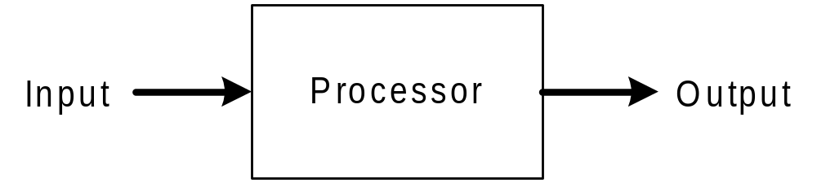
Definition of Information
System?
=
Information System Design
Notes:
Lecture# 02
July 26. 2007
IT60105: D Samanta, SIT, IIT Kharagpur

Slide 13
What is an Information System?
An Information System is a combination of
  Hardware
  Software
  Telecommunication networks (Internet)
Which people build and use to
  Collect
  Create
  Distribute data
Typically in
  Organizational setting
Information System Design
Notes:
Lecture# 02
July 26. 2007
IT60105: D Samanta, SIT, IIT Kharagpur

Slide 14
What is an Information System?
An Information System (IS) is a coordinated set of people, procedures, hardware, software, data, and communication networks that collects, processes, stores, and distributes information to support an organization's operations, management, and decision-making.
In simple terms, an information system converts raw data into meaningful information that helps individuals and organizations make better decisions.
Information System Design

Slide 15
Components of an Information System
Hardware
Physical devices such as computers, servers, printers, scanners, and storage devices.
Software
Programs and applications used to process data, including operating systems and application software.
Data
Raw facts and figures that are collected, processed, and stored to produce useful information.
People / Users
End users, managers, system analysts, programmers, database administrators, and IT staff who develop, operate, and maintain the system.
Procedures
Rules, policies, and methods that govern how data is collected, processed, and managed.
Communication Networks
Technologies such as LAN, WAN, and the Internet that enable data sharing and communication.
Information System Design

Slide 16
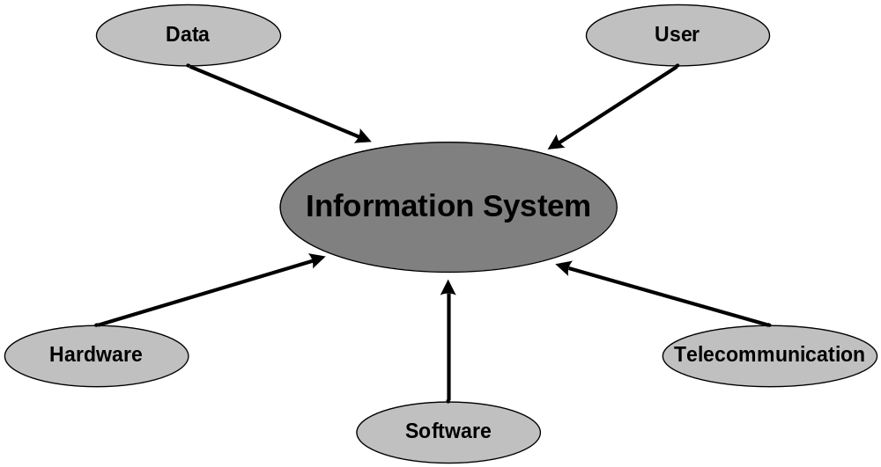
Components of an Information System
Information System Design
Notes:
Lecture# 02
July 26. 2007
IT60105: D Samanta, SIT, IIT Kharagpur

Slide 17
Example of Information Systems
Library Information System
Information retrieval system
Geographical Information System
On-line Business Transaction
Microsoft Office
www.scs.dauniv.ac.in
MatLab
Information System Design
Notes:
Lecture# 02
July 26. 2007
IT60105: D Samanta, SIT, IIT Kharagpur

Slide 18
Information System Types
Transaction Processing Systems (TPS)
Management Information Systems (MIS)
Decision Support Systems (DSS)
Expert System and Artificial Intelligence (ES &AI)
Information System Design

Slide 19
Transaction Processing Systems (TPS)
A Transaction Processing System (TPS) is an information system that records, processes, stores, and manages an organization's routine day-to-day business transactions accurately and efficiently.
A TPS is designed to handle a large volume of repetitive transactions, ensuring that business operations are carried out smoothly and reliably.
Information System Design

Slide 20
Transaction Processing Systems (TPS)
Objectives of TPS
Process daily business transactions accurately.
Reduce manual work and human errors.
Maintain up-to-date records.
Improve operational efficiency.
Provide data for other information systems such as MIS and DSS.
Ensure fast and secure transaction processing.
Information System Design

Slide 21
Transaction Processing Systems (TPS)
Characteristics of TPS
Processes a high volume of transactions.
Fast and reliable processing.
High accuracy and consistency.
Handles repetitive and routine tasks.
Provides data security and backup.
Supports real-time or batch processing.
Ensures data integrity and availability.
Information System Design

Slide 22
Transaction Processing Systems (TPS)
Components of TPS
Input
  Transaction data such as sales orders, customer details, and payment information.
Processing
  Validates, calculates, updates, and stores transaction data.
Database
  Stores transaction records for future retrieval.
Output
  Generates receipts, invoices, reports, and updated records.
Feedback
  Helps monitor and improve system performance.
Information System Design

Slide 23
Management Information Systems (MIS)
A Management Information System (MIS) is an information system that collects data from various sources, processes it, and provides timely, accurate, and relevant information to managers for planning, controlling, monitoring, and decision-making.
MIS primarily uses data generated by the Transaction Processing System (TPS) to produce summarized reports that help middle-level managers to make effective decisions.
Information System Design

Slide 24
Management Information Systems (MIS)
Objectives of MIS
Provide accurate and timely information to managers.
Support planning, organizing, and controlling activities.
Improve the quality of managerial decision-making.
Monitor organizational performance.
Increase operational efficiency and productivity.
Facilitate communication among departments.
Information System Design

Slide 25
Management Information Systems (MIS)
Characteristics of MIS
Management-oriented.
Uses data from TPS and other sources.
Produces summarized and structured reports.
Provides timely, accurate, and relevant information.
Supports routine and tactical decisions.
Improves coordination between departments.
Flexible and user-friendly.
Information System Design

Slide 26
Management Information System (MIS)
Components of MIS
Hardware
  Computers, servers, storage devices, and networking equipment.
Software
  Operating systems, database software, and business applications.
Database
  Stores organizational data for processing and reporting.
People
  Managers, employees, system analysts, programmers, and database administrators.
Procedures
  Rules and methods for collecting, processing, and reporting information.
Communication Networks
  LAN, WAN, and the Internet for information sharing.
Information System Design

Slide 27
Decision Support systems (DSS)
A Decision Support System (DSS) is a computer-based information system that helps managers and decision-makers to analyse the data, evaluate alternatives, and make informed decisions for semi-structured and unstructured problems.
A DSS combines data, analytical models, and user-friendly software to support decision-making. It assists managers by providing insights and recommendations rather than making decisions automatically.
Information System Design

Slide 28
Decision Support systems (DSS)
Objectives of DSS
Support managers in making effective decisions.
Analyze complex business problems.
Evaluate multiple alternatives.
Improve the quality and speed of decision-making.
Assist in forecasting and planning.
Reduce uncertainty and business risks.
Information System Design

Slide 29
Decision Support systems (DSS)
Characteristics of DSS
Supports semi-structured and unstructured decisions.
Interactive and user-friendly.
Uses analytical and mathematical models.
Integrates data from multiple sources.
Provides "what-if" and sensitivity analysis.
Flexible and adaptable to changing business needs.
Supports individual and group decision-making.
Information System Design

Slide 30
Decision Support systems (DSS)
Components of DSS
Database
  Stores internal and external data required for analysis.
Model Base
  Contains statistical, financial, forecasting, optimization, and simulation models.
Software/User Interface
  Enables users to interact with the system and perform analyses.
Knowledge Base (Optional)
  Stores rules, expertise, and business knowledge to assist in decision-making.
Users
  Managers, analysts, and decision-makers who use the system.
Information System Design

Slide 31
Expert System and Artificial Intelligence
An Expert System (ES) is an Artificial Intelligence (AI)-based computer system that mimics the knowledge and decision-making ability of a human expert to solve complex problems in a specific domain.
It uses a knowledge base and an inference engine to provide advice, recommendations, diagnoses, or solutions similar to those of a human expert.
Information System Design

Slide 32
Expert System and Artificial Intelligence
Objectives of Expert Systems
Provide expert-level advice and solutions.
Assist users in making accurate decisions.
Preserve and share expert knowledge.
Improve the speed and consistency of problem-solving.
Reduce dependence on human experts.
Increase productivity and efficiency.
Information System Design

Slide 33
Expert System and Artificial Intelligence
Characteristics of Expert Systems
Knowledge-based system.
Uses logical reasoning to solve problems.
Provides consistent and reliable solutions.
Can explain how a conclusion was reached.
Works in a specific domain of expertise.
Available 24/7 without fatigue.
Learns through knowledge updates (not automatically unless integrated with machine learning).
Information System Design

Slide 34
Expert System and Artificial Intelligence
Components of an Expert System
Knowledge Base
  Stores facts, rules, and expert knowledge related to a specific domain.
Inference Engine
  Applies logical reasoning to the knowledge base to draw conclusions and make decisions.
User Interface
  Allows users to interact with the expert system by entering queries and receiving advice.
Knowledge Acquisition Module
  Collects and updates knowledge from human experts or other reliable sources.
Explanation Facility
  Explains how the system reached a particular conclusion or recommendation.
Information System Design

Slide 35
Exercises
Identify the different components in the following systems: Library Information System, Microsoft Office, Cellular Phone.
Identify systems, which are not information systems?
Describe the various types of Information Systems along with their merits and demerits.
Explain the applications of each category of information systems?
Information System Design
Notes:
Lecture# 02
July 26. 2007
IT60105: D Samanta, SIT, IIT Kharagpur

